Slide 1


capstone project phase B
Social network for healthy life
supervisor: Dr. Zakharia Frenkel
Group members: Reem Kadmany & Roaa Bader
GitHub link: https://github.com/roaab3/SocialnetworkForHealth

Slide 2

Online Health community
Online chat groups in which people can share their experiences about a health topic and seek/provide support to the members.

Slide 3
Motivation
Over time, online health communities become more massive. As a result, finding trustworthy information can take a lot of time and effort that's why we need a fast and reliable way to get trustworthy information.
Our project is a follow-up to another project that we will improve.
Quality
Service

Slide 4



OUR SOLUTION
A Social Network For Healthy Life

Slide 5

In our Social Network For Health Life a user can:
1
Join communities where each community has an admin.
2
Share a medical experience he went through to help others.
3
Seek support from other members.
4
Attend online lectures using ZOOM.

Slide 6

In our Social Network For Health Life a moderator can:
1
Share his knowledge and offer support.
2
Check the reliability.
3
Remove unreliable content.

Slide 7




Features
Service history
Asking and
answering questions
Awards
Online meetings

Slide 8
Features
Service history
Awards
Asking and
answering questions
Online meetings

Slide 9
Features
Service history
Asking and
answering questions
Awards
Online meetings

Slide 10
Features
Service history
Asking and
answering questions
Service history
Awards
Online meetings

Slide 11



Features
Moderator verification
Image sharing
Interaction Tools

Slide 12
Features
Moderator verification
Image sharing
Interaction Tools

Slide 13
Features
Moderator verification
Image sharing
Interaction Tools

Slide 14


ALGORITHMIC CHALLENGES

Slide 15

Awarding system
  Task: the system should encourage the users’ activities to motivate them to stay active on the social network.
  Our solution:
    Each user will receive a bonus based on their actions.
  The formula:
    For creating a new club, the user will get 10 points.
    For adding a new post/comment/like, the user will get 5 points.

Slide 16

Asking and answering questions
  Task: answer optimal answers for a wide range of questions.
  Our solution:
    The user can post a question.
    The moderator makes sure that the answers are reliable.

Slide 17
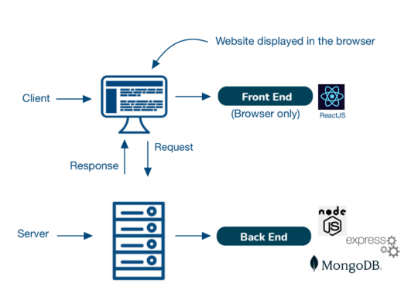
Algorithm
Technologies

Slide 18



Constraints
React JS
Node Js
Mongo DB

Slide 19
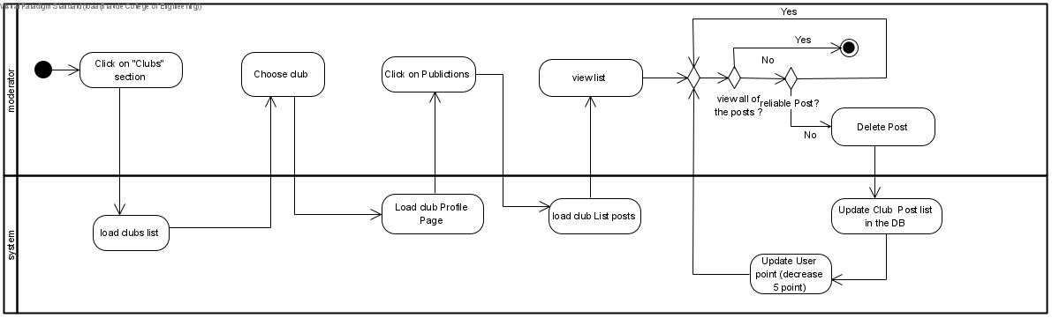
Activity Diagram
Moderator Verification

Slide 20
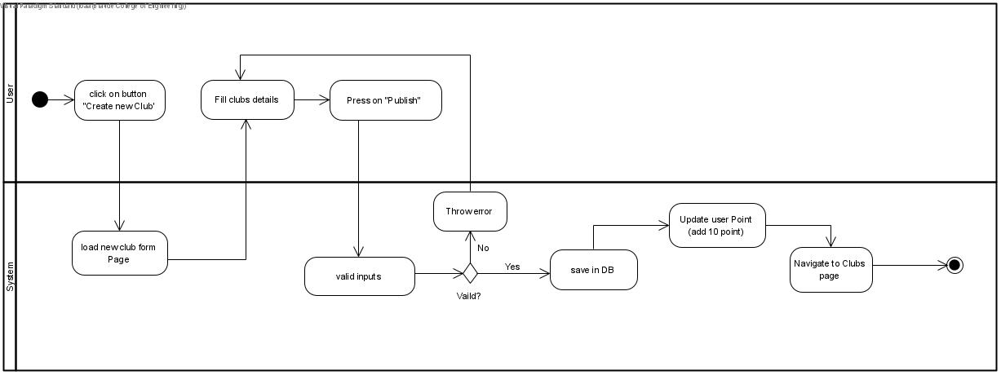
Activity Diagram
Creating a New Club

Slide 21
Implementation process
Step 1
Analyze Feature
Step 2
Implement Feature
Step 3
Test Feature
Step 4
Integrate Feature And Test The Integrated website

Slide 22
Implementation process
Step 1
Analyze Feature
Step 2
Implement Feature
Step 3
Test Feature
Step 4
Integrate Feature And Test The Integrated website

Slide 23
Implementation process
Step 3
Test Feature
Step 1
Analyze Feature
Step 2
Implement Feature
Step 4
Integrate Feature And Test The Integrated website

Slide 24
Implementation process
Step 4
Integrate Feature And Test The Integrated website
Service history
Step 2
Implement Feature
Step 3
Test Feature
Step 1
Analyze Feature

Slide 25
Verification Plan
Break down our website into small components and tested each component.
Tested the integrated website.

Slide 26
Challenges during the implementation process
  Data Structure.
  Implementing the moderator role.
  Finding the right software.

Slide 27
Our website has several interfaces:
Unlogged User
Logged User
Moderator
Add posts and comments
Delete posts
View clubs
View authors
Create/
Subscribe to authors
Edit profile/club
Delete comments
subscribe to clubs
Make sure that the content is reliable
View posts
View comments
View the active users/clubs

Slide 28
Example With Video

Slide 29
THANK YOU FOR
LISTENING
TOP OF THE LINE
MEDICAL SERVICE PROVIDER

